Slide 1
Nuove conoscenze sull'impatto sulla salute delle diseguaglianze sociali
Il capitale biologico
Paolo Vineis
Modena 5 Maggio 2023

Slide 2
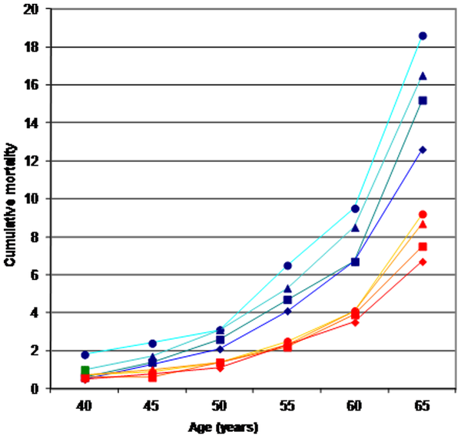

Slide 3
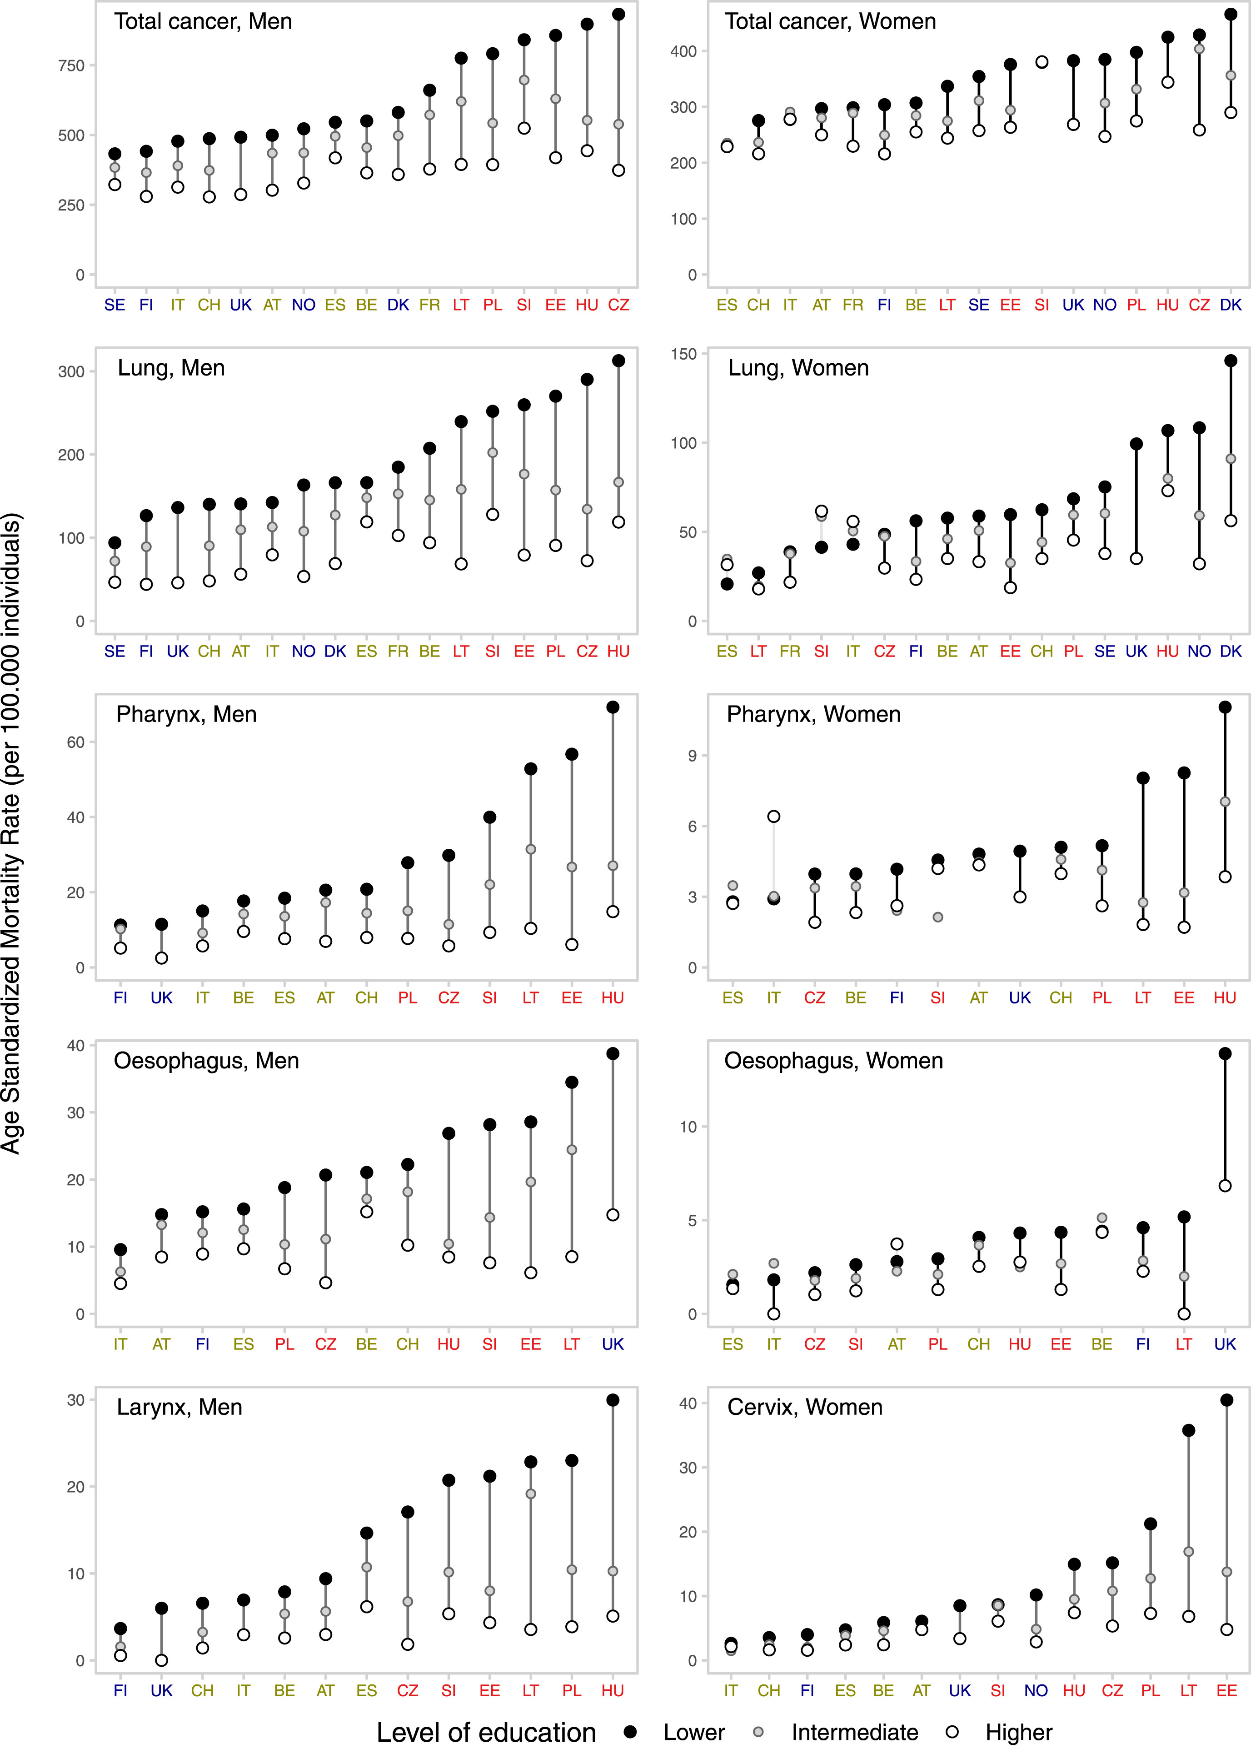
Fig. 1
Educational inequalities between and within countries in total cancer mortality, and for type-specific cancers, in Europe, by sex, for the last period of observation. Footnote: in each panel, countries are ordered (from left-to-right) according to an increasing level of ASMR for lower-educated. The period of observation varies between 1998 and 2015, depending on the country. North; West/South; Baltic/Central/Eastern. Vaccarella et al. Lancet Reg Health Eur. 2022 Nov 28;25:100551.
The Lancet Regional Health – Europe DOI: (10.1016/j.lanepe.2022.100551)
Notes:
Educational inequalities between and within countries in total cancer mortality, and for type-specific cancers, in Europe, by sex, for the last period of observation. Footnote: in each panel, countries are ordered (from left-to-right) according to an increasing level of ASMR for lower-educated. The period of observation varies between 1998 and 2015, depending on the country. North; West/South; Baltic/Central/Eastern.

Slide 4
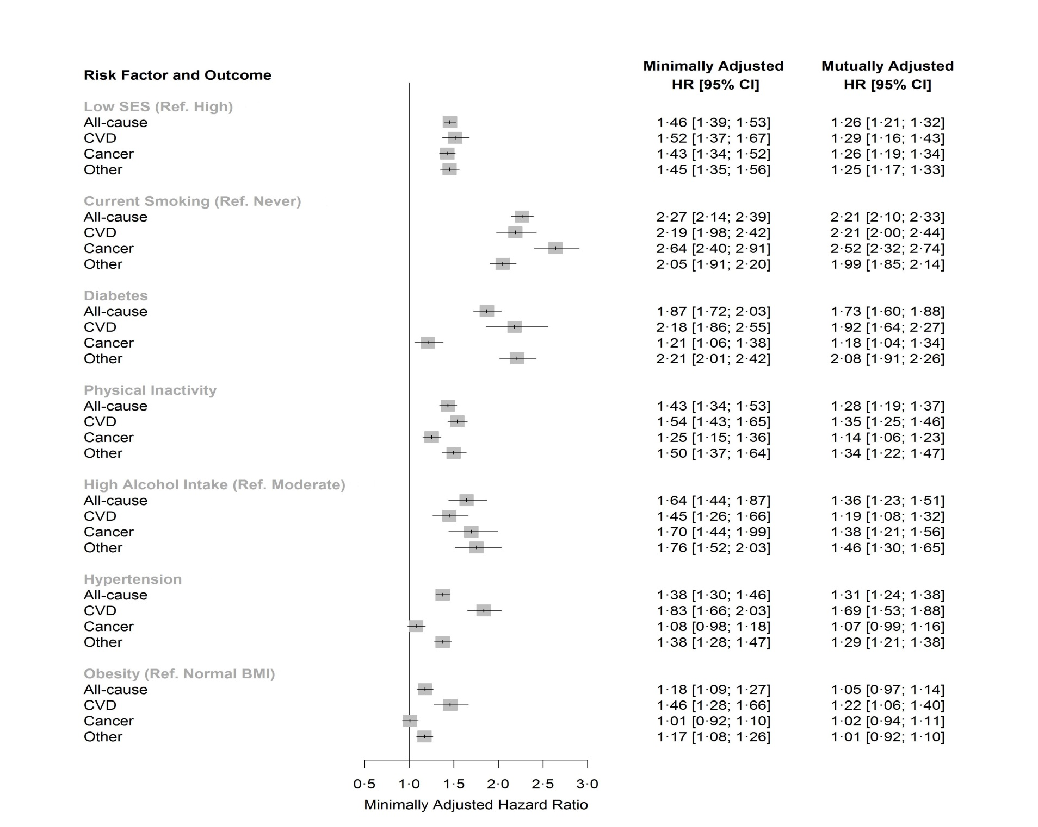
Stringhini et al, Lancet 2017 Mar 25;389(10075):1229-1237

Slide 5
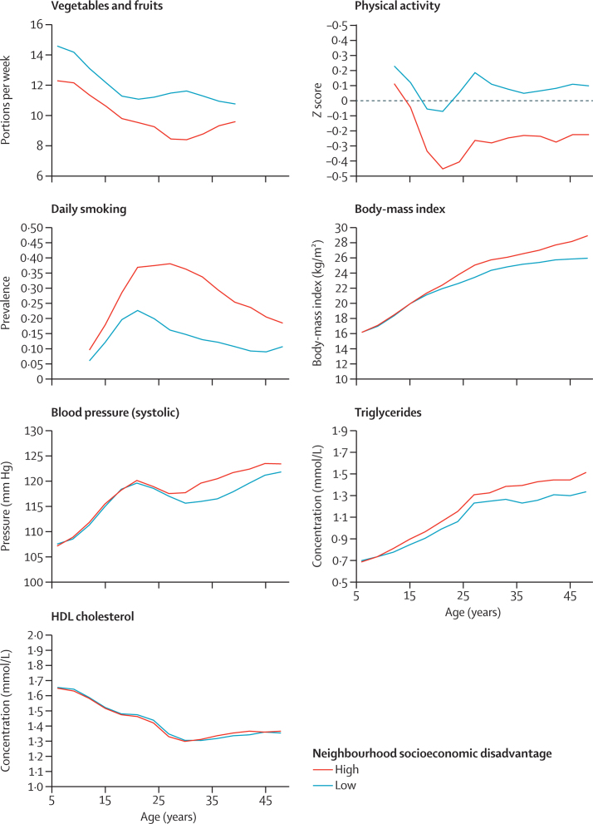
Risk factors of cardiometabolic health by age and cumulative neighbourhood socioeconomic disadvantage
The cutoff for high neighbourhood socioeconomic disadvantage is >0·5 SD above the national mean and the cutoff for low neighbourhood socioeconomic disadvantage is more than or equal to 0·5 SD below the national mean
Red Low SES, Blue High SES
Kivimaki et al Lancet PH 2018 Aug; 3(8): e365–e373

Slide 6
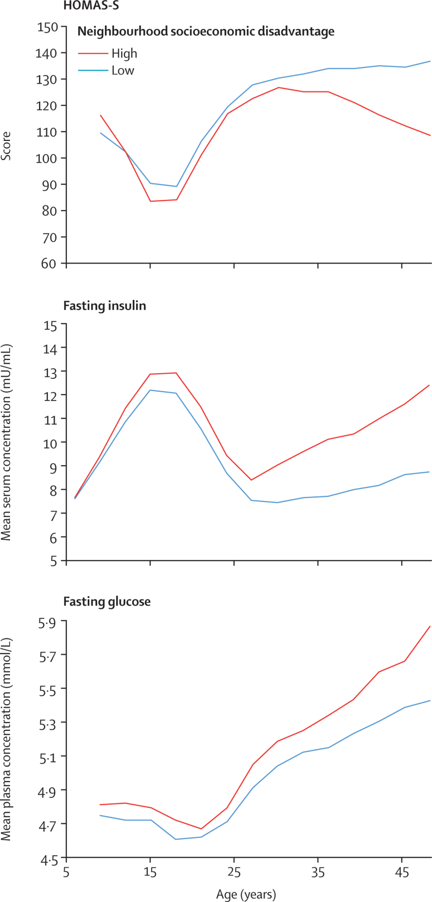
Risk factors for diabetes by age and cumulative neighbourhood socioeconomic disadvantage
The cutoff for high neighbourhood socioeconomic disadvantage is >0·5 SD above the national mean and the cutoff for low neighbourhood socioeconomic disadvantage is more than or equal to 0·5 SD below the national mean.
HOMA-S=homoeostasis model assessment insulin sensitivity.
Red Low SES, Blue High SES
Kivimaki et al Lancet PH 2018 Aug; 3(8): e365–e373

Slide 7
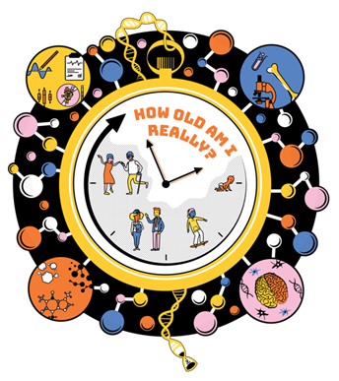
Intermediate exposures (environment behaviour etc.)
Economic capital
Social capital
Cultural capital
Health outcomes
Constitutive biological capital
Induced biological capital
lifecourse
The exposome as the science of social-to-biological transitions. Vineis P, Barouki R.Environ Int. 2022 May 21;165:107312.

Slide 8
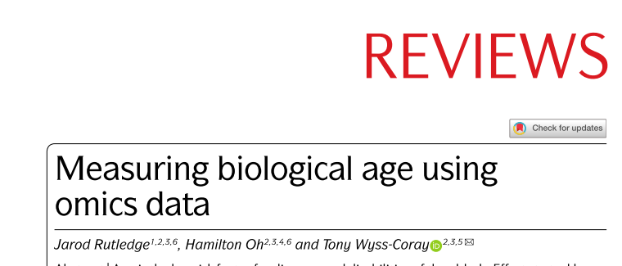
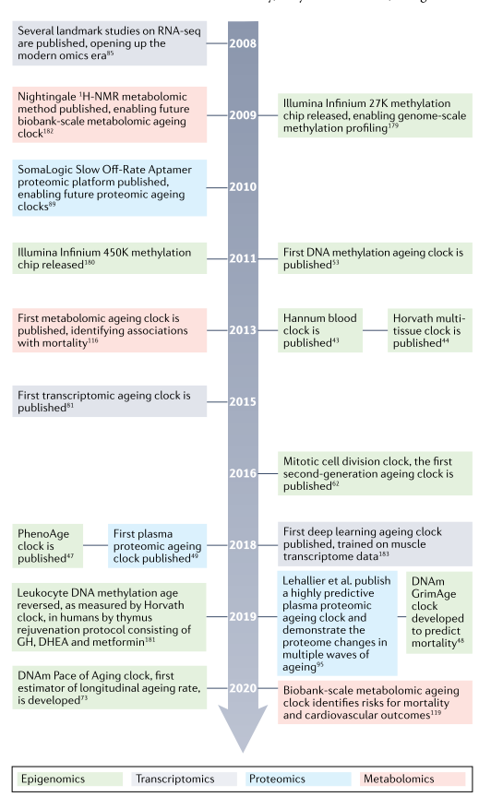
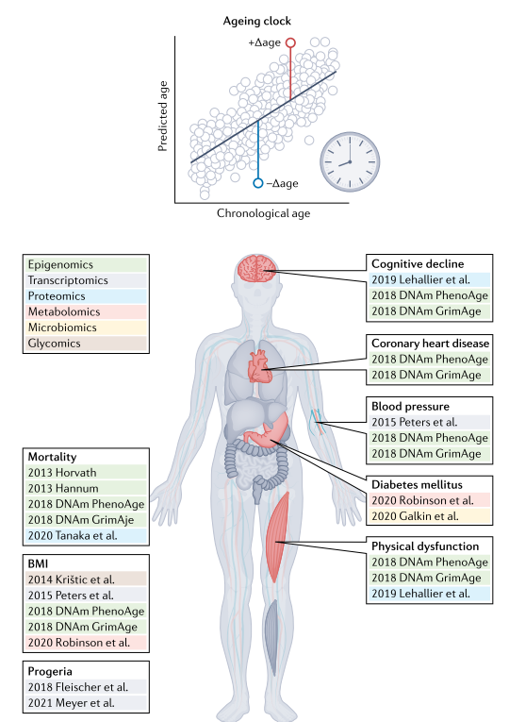


Slide 9
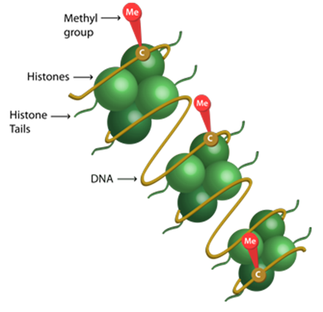
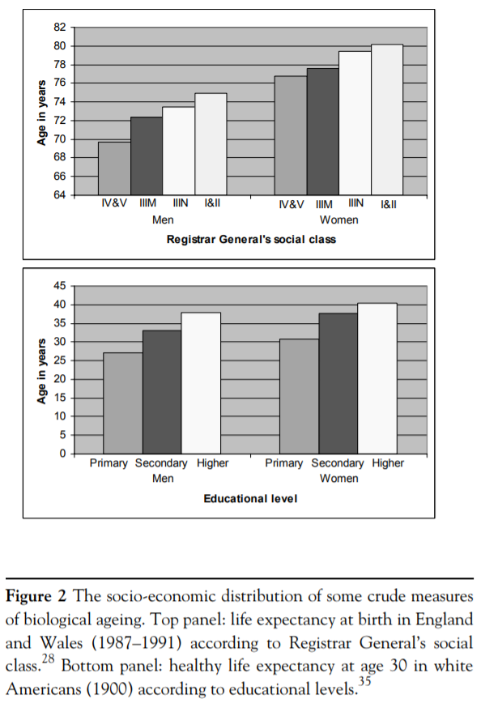
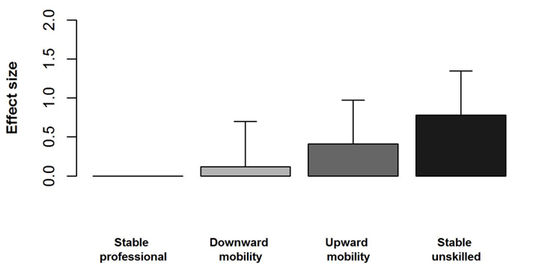
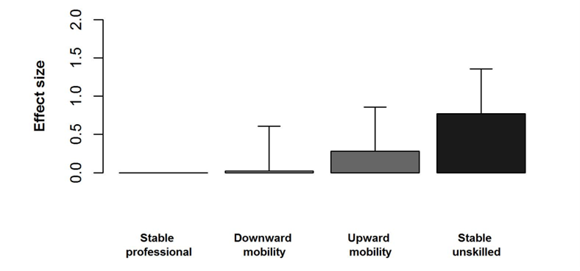

Socio-economic position and biological aging
Association between Life-course SEP and DNA methylation age acceleration
Basic model
Full model
Analysis of 2,300 people in two population cohorts in Italy and Ireland
Fiorito (2017) Nat Sci Reports
Notes:
Coparison of GAZEL and WHITEHALL studies

Slide 10
Categorie che richiedono particolare attenzione

Slide 11
Employed and unemployed men and women (n = 631) from the UK Understanding Society study.
Unemployment:
HorvathAA (1.51, 95% CI 0.08, 2.95)
GrimAgeAA (1.53, 95% CI 0.16, 2.90)
PhenoAA (3.21, 95% CI 0.89, 5.33)
Job insecurity PhenoAA (1.83, 95% CI 0.003, 3.67)
Working at night GrimAgeAA (2.12, 95% CI 0.69, 3.55)
Freni Sterrantino et al Association between work characteristics and epigenetic age acceleration: cross-sectional results from UK – Understanding Society study. Ageing Volume 14, Issue 19 pp 7752—7773 2022

Slide 12
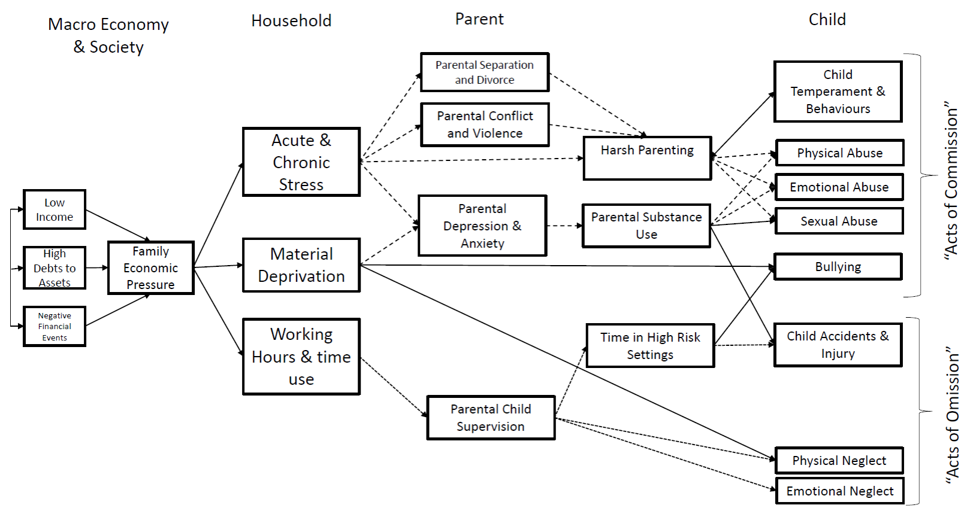

Slide 13
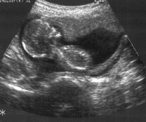
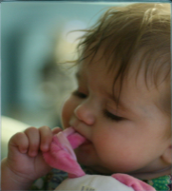


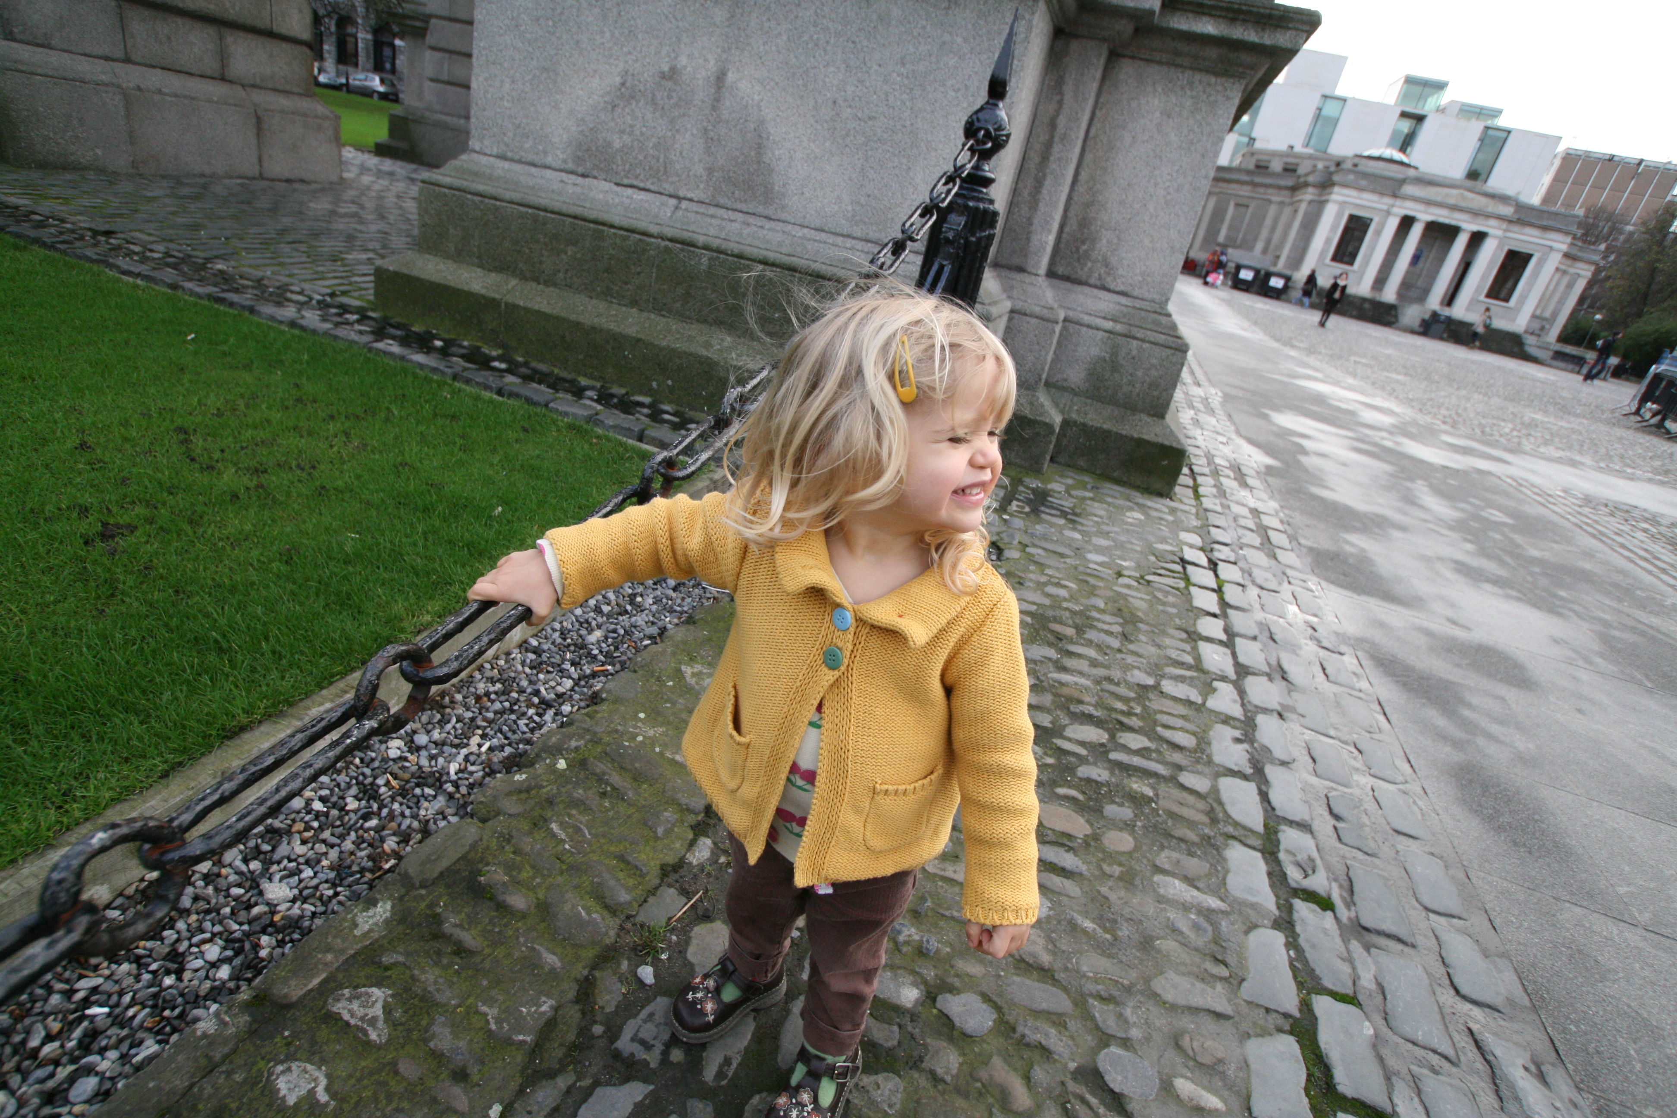

The First 2,000 Days & Children’s Cognitive and Socio-emotional Skills: Evidence from a Randomized Experiment of Home Visiting
Dr. Orla Doyle (University College Dublin, currently Paris School of Economics & University of Bordeaux)
Notes:
Thanks for invitation to present today. This paper is the final product from a 8 year study of a randomised control trial of an early intervention program called Preparing for Life.

Slide 14



Preparing for Life Program
PFL Participants
233
Random Assignment
HIGH TREATMENT
N = 115
LOW TREATMENT
N = 118
€100 worth of child developmental materials annually & book packs
Facilitated access to enhanced preschool
Public health workshops
Facilitated access to local services
Access to local PFL events
Home visiting program
Baby Massage
Triple P Positive Parenting Program
€100 worth of child developmental materials annually & book packs
Facilitated access to enhanced preschool
Public health workshops
Facilitated access to local services
Access to local PFL events

Slide 15

Distribution of BAS GCA Cognitive Scores

Slide 16
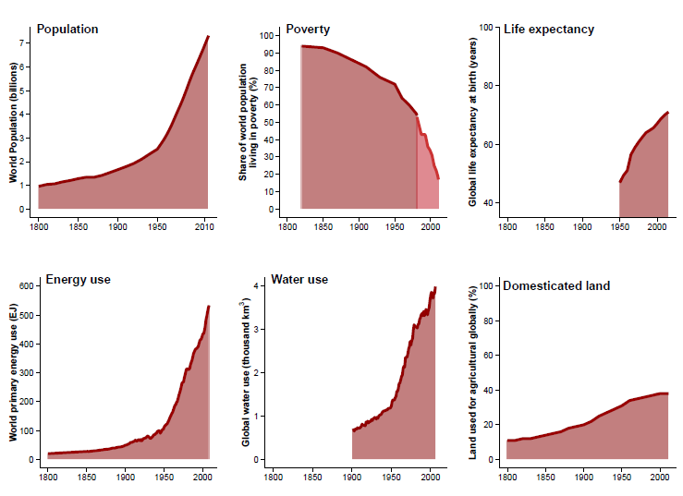
Miglioramenti secolari nella qualità della vita e attesa di vita

Slide 17
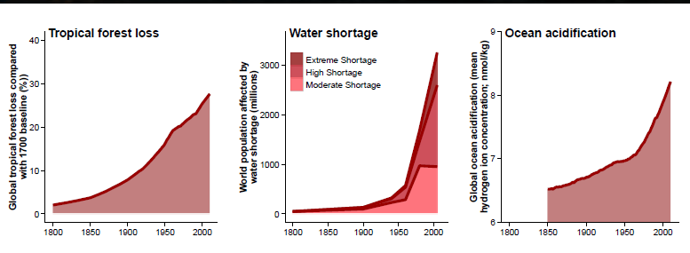
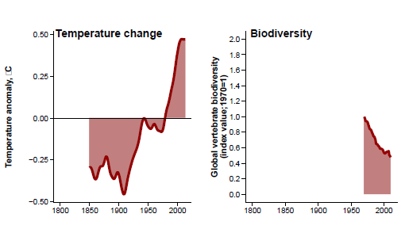
… che però compromettono la qualità della vita delle generazioni future

Slide 18
La prevenzione è necessaria ma resta sottofinanziata
Più tardiva è la prevenzione e maggiori sono le conseguenze, anche economiche, che si debbono pagare sul medio-lungo termine. In 9 paesi esaminati, rispettando il trattato di Parigi sul clima vi sarebbe una riduzione di 1,18 milioni di morti entro il 2040 per la diminuzione dell’inquinamento atmosferico, di 5,86 milioni per gli interventi sulla produzione di cibo, e di 1,15 milioni per un aumento dell’attività fisica (Hamilton et al, 2021).
Vi è uno scollamento tra i meccanismi programmatori e finanziari del PNRR e il Piano nazionale della prevenzione 2021-25, finanziato dal Patto per la salute 2020-21 con 200 milioni (una cifra formulata a prescindere dai contenuti e dalle reali esigenze operative del Piano).
La concezione One Health, ripetutamente indicata nel PNRR, richiederebbe che la prevenzione da ruolo residuale divenisse centrale.

Slide 19
Ministero della Salute
Consiglio Superiore di Sanità
Sessione LIII (2022-2025)
Presidente: Prof. Franco Locatelli
“Riforma dei Sistemi Informativi Sanitari:
sperimentazioni e legislazione sulla privacy”
Coordinatore: Prof. Paolo Vineis
Vice-coordinatore: Prof. Franco Locatelli
Disponibile sul sito del Ministero della Salute

